Slide 1
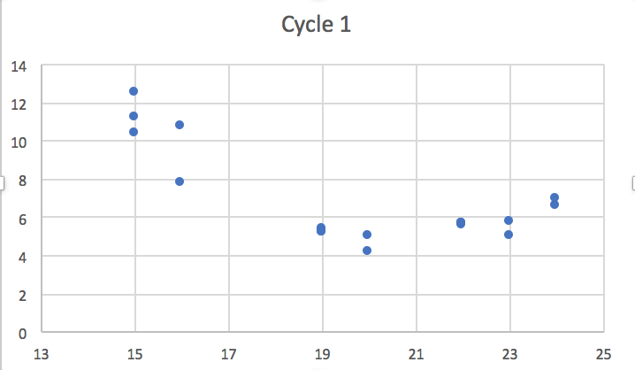
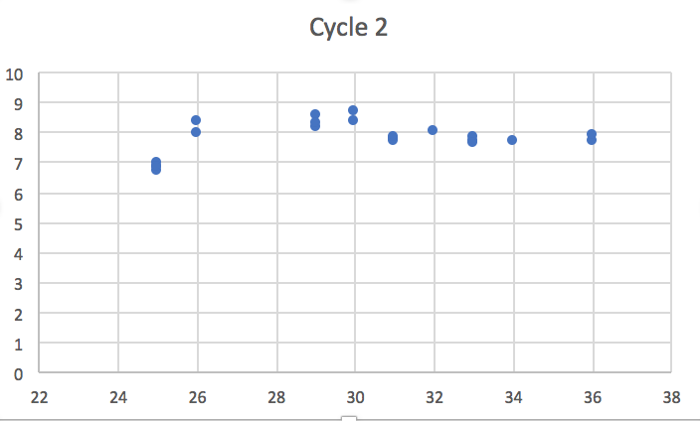
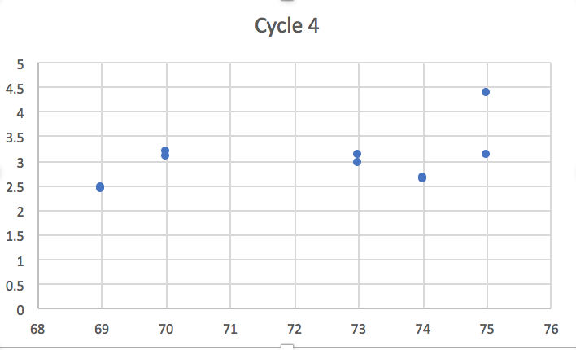
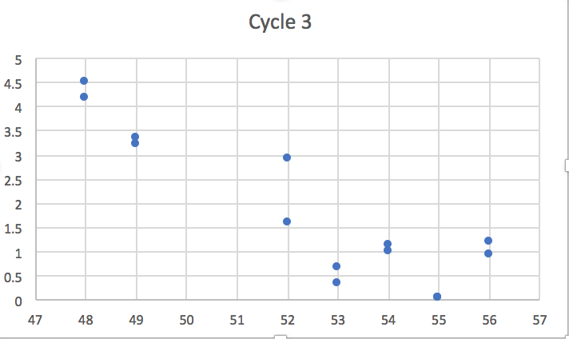
Nitrate concentration in surface 15 m
Nitrate
(uM)
Nitrate
(uM)
Cast
Cast
Nitrate
(uM)
Nitrate
(uM)
Cast
Cast

